Slide 1
AI-Based Phishing Website Detection App
An AI-powered approach
for safer browsing
An AI-powered approach for safer browsing
• Presented by : Devadarshini D (25105051)
• Department : CSE - A
• College : Rathinam Technical Campus
• Technology : Python + Machine Learning

Slide 2
Introduction
Phishing websites are fake websites designed to steal sensitive information.
Users may unknowingly share passwords, banking details, or personal information.
Phishing URLs can look very similar to genuine URLs.
Our application helps users check a website before accessing it.
The app uses AI and Machine Learning to analyze URLs.

Slide 3
Problem Statement
Problem:
Users may find it difficult to identify whether a website is genuine or phishing.
Proposed Solution:
Develop an application that allows users to:
Enter or paste a website URL.
Scan the URL.
Analyze its characteristics using AI.
Get an instant Legitimate / Phishing result.

Slide 4
Objectives
Develop a simple and user-friendly phishing detection app.
Detect suspicious URLs automatically.
Use Machine Learning for URL classification.
Provide quick and understandable results.
Help users avoid potentially harmful websites.

Slide 5
App Features
🔍 URL Scanner - Enter or paste a website URL.
🤖 AI Detection - Analyzes URL features using a trained ML model.
🟢 Legitimate Result-Indicates that the URL appears legitimate.
🔴 Phishing Alert - Warns the user when the URL is classified as phishing.
📊 Risk Information - Displays suspicious characteristics detected in the URL.

Slide 6
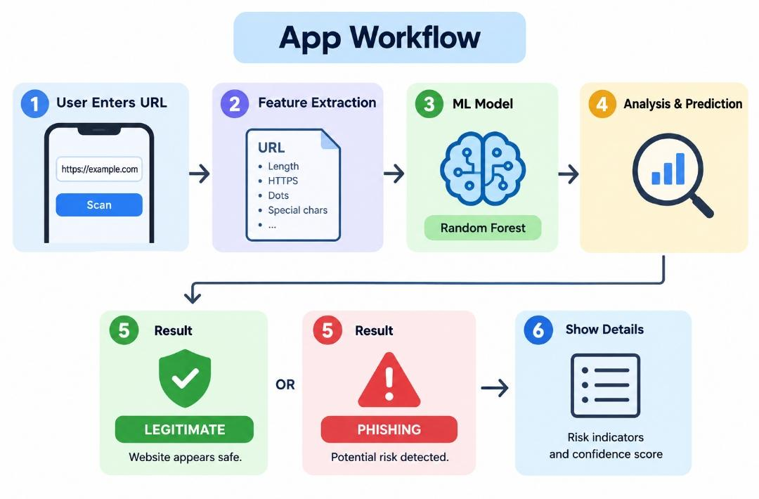
How the App Works

Slide 7
AI / ML Features
The application analyzes different URL characteristics:
• URL length
• HTTPS availability
• Number of dots
• Number of special characters
• Number of subdomains
• IP address usage
• Suspicious keywords
• @ symbol usage
These features are provided to the Machine Learning model for prediction.

Slide 8
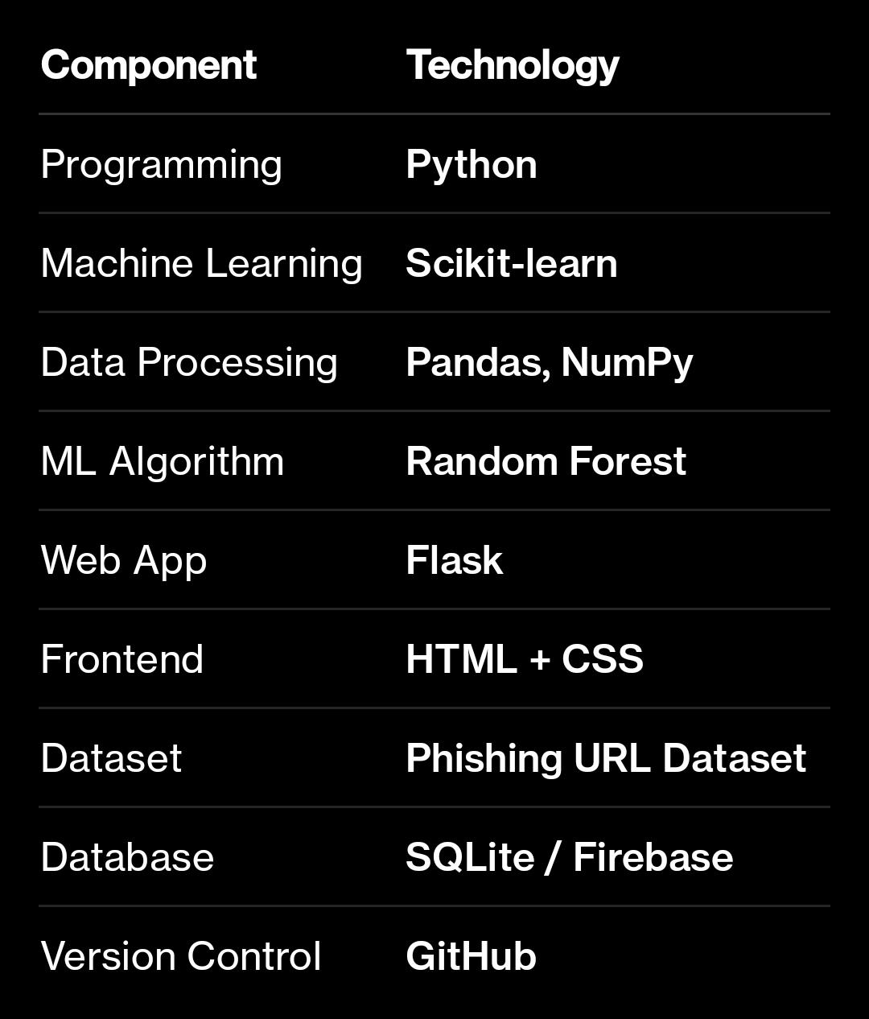
Technology Stack

Slide 9
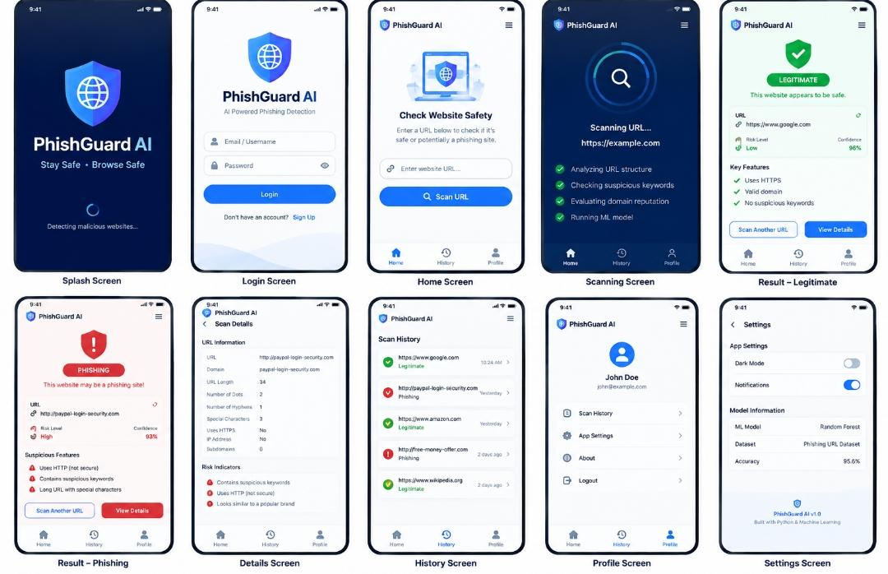
App Screen Design

Slide 10
Advantages
Easy to use.
Fast URL analysis.
AI-based detection.
User-friendly interface.
Provides phishing warnings.
Helps users make safer browsing decisions.
Can be improved with additional training data.

Slide 11
Future Enhancement
📷 QR-code URL scanning
🌐 Browser extension
🔔 Real-time phishing alerts
📜 Scan history
📊 Detailed risk analysis
☁️ Cloud-based ML model
🔄 Automatic model updates
📱 Mobile application

Slide 12
Conclusion
AI-Based Phishing Website Detection App provides a simple way to analyze suspicious URLs.
The application combines Python, Machine Learning and Cybersecurity to classify URLs as legitimate or phishing and provide users with an early warning.

Slide 13
THANK YOU
..

